Slide 1
2025 10M LP-N MTBF & PM+MD
Notes:
115/11/07

Slide 2
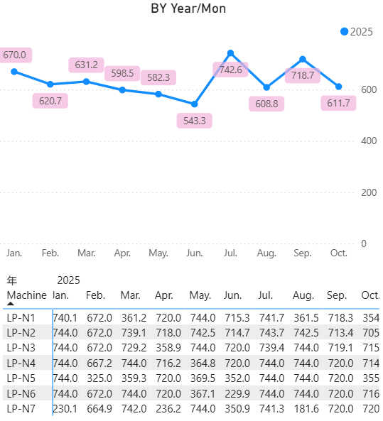
二、LP-N 10M MTBF
2025/10M LP-N MTBF： 611 < 680

Slide 3
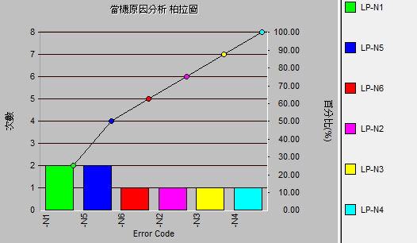
二、LP-N 10M MTBF 未達標
2025/10/02 LP-N6 3.32hrs
​​廠務借機更換 UPS-5 battery ok , 切回 UPS 供電 ok
2025/10/02 LP-N5 3.30hrs
​​廠務借機更換 UPS-5 battery ok , 切回 UPS 供電 ok
2025/10/06 LP-N3 4.05hrs
​巡視Cooler溫度
cooler-1溫度偏高idle 16x℃、cooler 2 溫度15x，Run時電流正常
後續run N01 step-3 PUI+N2 alarm, current = 13A持續3秒
Replace cooler-1 TC piping (8/26已換cooler-1/2)
2025/10/06 LP-N4 5.60hrs
因4PM抓漏NG, 有換Pirani sensor
後續test run APC angle OOS
換回原Pirani sensor test ok

Slide 4
二、LP-N 10M MTBF 未達標
2025/10/08 LP-N1 5.13hrs
Run N08 step-6 PRESSUP, check RMS step-5壓力0.14
Cap上有碎石英, clean ok
抓漏Vac piping與Manifold連接處有漏, 升到6*10^-6
Replace vac piping, test run ok
2025/10/08 LP-N5 6.15hrs
Run N01 step-3 PUI+N2, current=13.1A持續2秒, cooler溫度MAX=154 無超溫
Replace cooler-1/2、cooler-1 TC piping, test run ok
2025/10/15 LP-N1 5.70hrs
定期更換轉子，check rotation、transfer ok
2025/10/16 LP-N2 14.1hrs
​run N08 APC angle=39 ooc(run count:136)
test pressure set: 0.25, N2 set: 350 APC: 48
APC軸桿2個止付螺絲鎖緊, test run ok

Slide 5
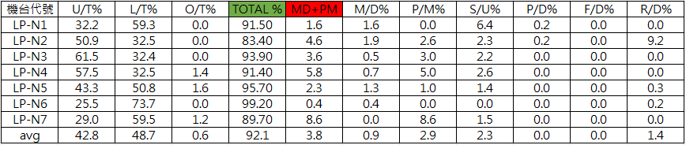
四、LP-N 10M U/T & PM+MD
2024 10M LP-N PM+MD： 3.8 < 4%

Slide 6
LP-N PTC OOS RATE REPORT

Slide 7
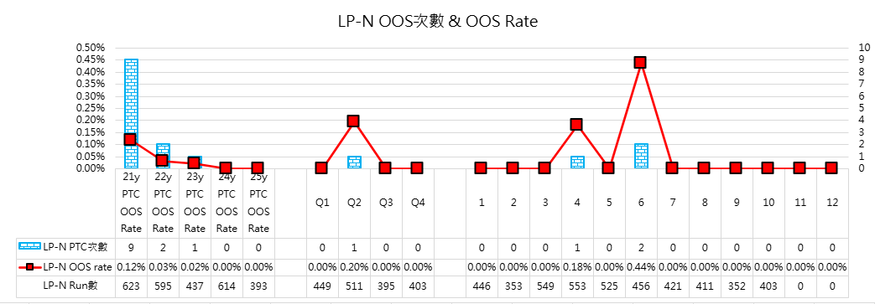
2025Y LP-N PTC OOS Rate
10M LP-N PTC OOS Rate = 0.00%

Slide 8
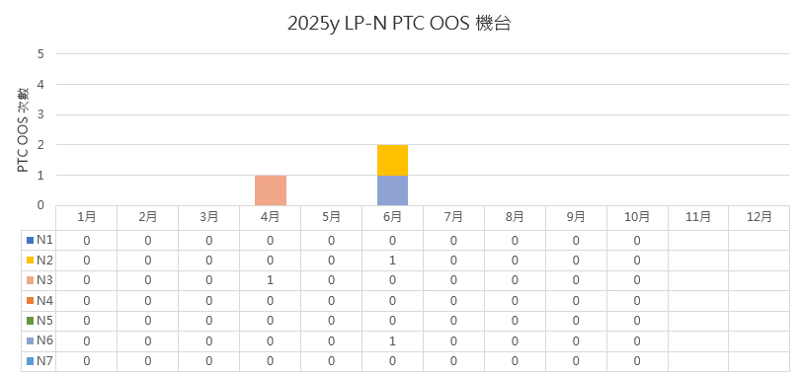
2025Y LP-N PTC OOS 次數

Slide 9
2025Y LP-N PTC OOS
10M PTC OOS 共有 0 次，申請刪除0次

